Slide 1






Slide 2
What is “engaging content”?
“Engaging” is one of those words that can have different shades of meaning.
What does it mean to you?

Slide 3
A Working Definition:
Engaging content is something that the audience values and appreciates, and makes them want to be connected with you.
It should be:
  Relevant
  Helpful/Educational
  A solution to a problem
  Original/Creative

Slide 4
What is “content marketing”?
Content marketing is the process of engaging with a defined target market by providing valued information primarily through interactive media, with the ultimate goal of producing sales.

Slide 5
What return should we expect?
Credibility
Authority
Trust
Differentiation
Relationship-building
Leads/inquiries
Brand awareness
Brand preference

Slide 6
The Power of Words
https://www.youtube.com/watch?v=Hzgzim5m7oU&feature=youtu.be

Slide 7
Creating Engaging Content, Step One:
Make a Plan
If you don’t think it through up front…
…and commit it to writing…
you won’t get the results you want.
And you will waste money and time.
If you do…
everything that follows will be so much easier.
But don’t drive yourself crazy. Keep it simple.

Slide 8
Start with Goals
What results do you want? What returns do you expect? See above.
Realistic
Specific
Measureable

Slide 9

Know and understand your target market
What do they want from you?
What will help them succeed?
What are they interested in (that relates to your industry)?
  Problems, concerns, issues
  Opportunities you can help them with
  Information they could use.

Slide 10
Gathering intelligence on your target market
Ask them. Get feedback.
Read online reviews.
Monitor social media.
What can you provide that they don’t know to ask for?
How do you gather intelligence?

Slide 11
Decide how you’re going to reach them
What media do they use?
To make this manageable, think in terms of categories
Direct – when you have a way to make personal contact
Linked – networked contact: social media, blogs, articles, etc.
Digital Media – online ads, websites, microsites, directories, etc.
Mass Media – publicity, advertising, sales literature
Choose only the very best fits. Don’t try to do too much.
You can always expand later.

Slide 12
Prepare a content calendar
Use your target audience knowledge for subject ideas
Decide on frequency of posting, and where
Make it something you can live with
Quality beats quantity

Slide 13
Decide how you will measure results
Measure only the desired results you identified earlier
Pick a reasonable frequency…monthly is good
Don’t bother with stuff you can’t take action on

Slide 14
Creating Content that Engages

Slide 15
Some General Guidelines
Stay true to your objectives
Write for the audience (because now you know all about what they want)
Write what’s appropriate for the medium
  Sales copy in selling media only
  Newsletters should have news…useful information
  Social media and blog posts should be interesting/entertaining/useful/inspiring

Slide 16
More General Guidelines
Your audience is changing and evolving. Stay current with them
Give it some personality…you are unique

Slide 17
What to Write About – Content Ideas
Benefits, not features
Stuff you know, and they don’t…news, trends, events, helpful hints
Teach something…how-to’s
Solve a common problem
Mine your responses and feedback for more ideas

Slide 18
King & Prince Seafood on LinkedIn

Slide 19
More Sources for Content Ideas
Read online reviews: Yelp, Angie’s List, Facebook, Amazon, industry specific sites, etc.
Be a curator of info from elsewhere. But give credit.
Ask your employees for ideas
Answer questions
What else???

Slide 20
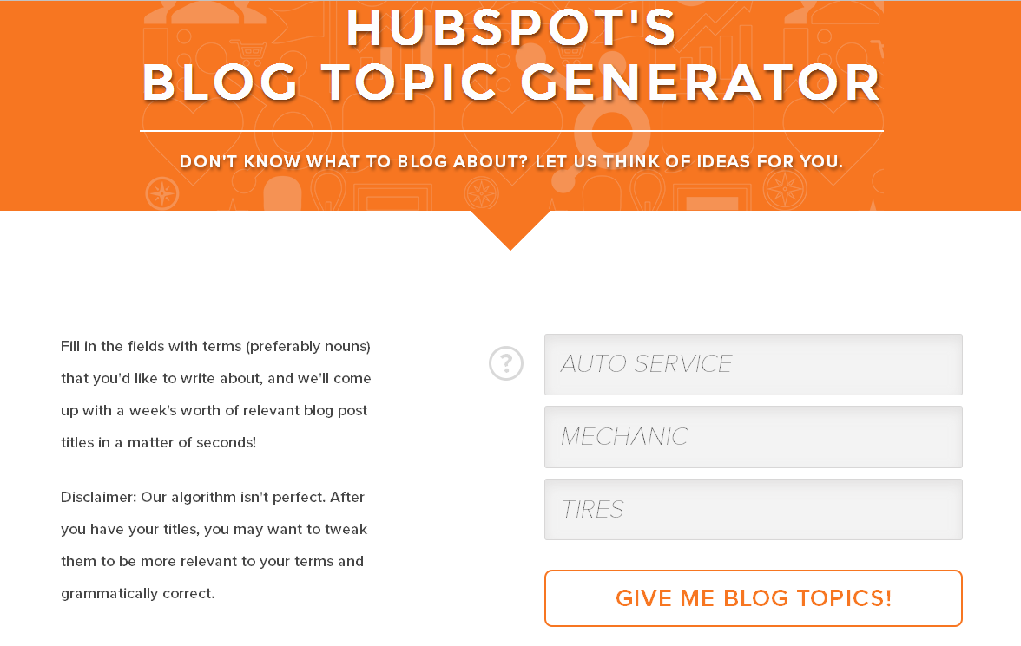

Slide 21
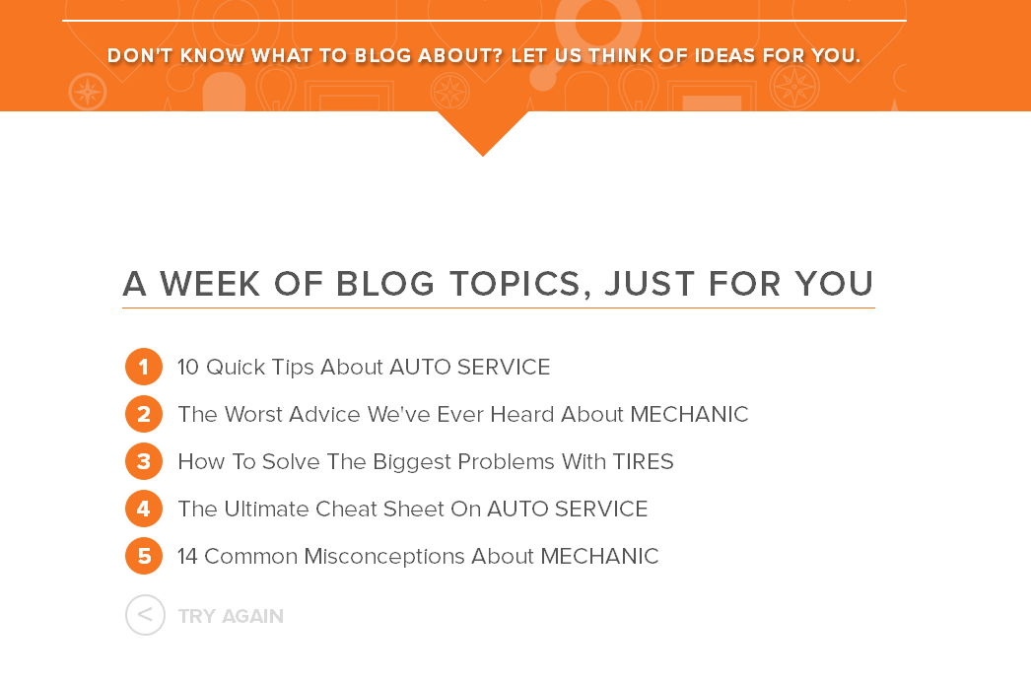

Slide 22
How to Get Engagement
Ask for it
Offer a reward. Who doesn’t like free stuff?
Venture an opinion (preferably something they will agree with)
Stories are always good…and you can ask for reactions
Encourage sharing
Write regularly. Obey your content calendar.

Slide 23
OK, we have this catalog. It’s full of great ideas. It sells our products. But it’s a catalog.
People get catalogs all the time. They use them to line their trash cans.
How do we get people interested in our catalog?

Slide 24
https://www.youtube.com/watch?v=MOXQo7nURs0
IKEA Catalog Video

Slide 25
Well
How to Write Good

Slide 26
“The secret of good writing is to strip every sentence to its cleanest components. Every word that serves no function, every long word that could be a short word, every adverb that carries the same meaning that's already in the verb, every passive construction that leaves the reader unsure of who is doing what—these are the thousand and one adulterants that weaken the strength of a sentence. And they usually occur in proportion to education and rank.”
On Writing Well
By William Zinsser

Slide 27
A useful online tool:
The Hemingway Editor http://www.hemingwayapp.com

Slide 28
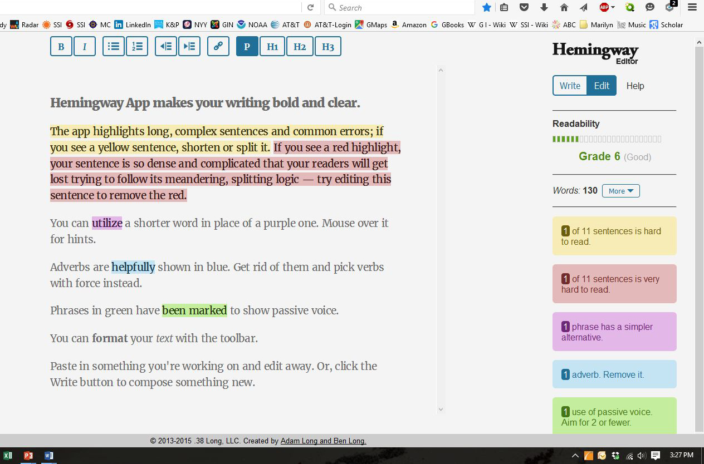

Slide 29
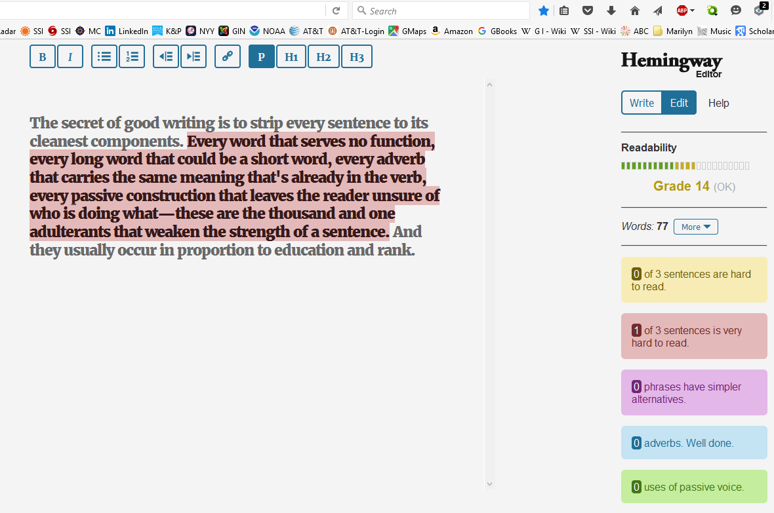
But do use it with a grain of salt.
Zinsser’s compound sentence is deliberate
emphasis.

Slide 30
Some Writing Tips and Ideas
Use the “inverted pyramid” especially on websites
Don’t let keywords or SEO mess up your writing
Paint pictures
Don’t forget the emotional component
Show empathy
Proofread

Slide 31
More Writing Tips and Ideas
Craft a compelling lead
The power of “you”
Tell stories
Strive for originality
  Ban corporate-speak
  Show clichés the door ☹
Write like you’re talking to friends
Collaborate whenever you can

Slide 32
If you’re serious about writing…
On Writing Well by William Zinsser
The Elements of Style by Strunk and White
Chicago Manual of Style by University of Chicago Press

Slide 33
More Resources about Engaging Content
ARTICLES
Why No One Is Reading Your Marketing Content
https://hbr.org/2015/12/why-no-one-is-reading-your-white-paper
5 Tips for Writing Content That Converts
http://www.business2community.com/content-marketing/5-tips-writing-content-converts-01444479
You, a Three Letter Power-Word
http://www.artofblog.com/you-three-letter-power-word/
Elmore Leonard’s 10 Rules of Writing
http://www.nytimes.com/2001/07/16/arts/writers-writing-easy-adverbs-exclamation-points-especially-hooptedoodle.html
How to Find More Content Ideas than You’ll Ever be Able to Create
http://www.copyblogger.com/get-ideas/
How to Use Marketing Communications to Dominate Your Industry
http://www.marcom-resources.com/uploads/How_to_Dominate_with_Marketing_Communications.pdf

Slide 34
More Resources about Engaging Content
ARTICLES
David Ogilvy’s 1982 Memo “How to Write”
http://www.openculture.com/2015/04/david-ogilvys-1982-memo-how-to-write-offers-10-pieces-of-timeless-advice.html
A Simple Trick to Turn Features Into Benefits (and Seduce Readers to Buy!)
http://www.enchantingmarketing.com/features-and-benefits/
9 Simple Tips for Writing Persuasive Web Content
http://www.enchantingmarketing.com/writing-for-the-web-vs-print/
Explained and Demonstrated: How to Find Your Messages in Reviews on Amazon and TripAdvisor
https://copyhackers.com/2014/10/amazon-review-mining/
26 Ways to Create Engaging Content
http://www.socialmediaexaminer.com/26-ways-to-create-engaging-content/

Slide 35
More Resources about Engaging Content
EDITING TOOL
http://www.hemingwayapp.com/ (Use it with a grain of salt)
TOPIC GENERATOR
http://www.hubspot.com/blog-topic-generator
VIDEO
The Power of Words
https://www.youtube.com/watch?v=Hzgzim5m7oU&feature=youtu.be
IKEA Catalog
https://www.youtube.com/watch?v=MOXQo7nURs0

Slide 36
More Resources about Engaging Content
WEBSITES
http://www.business2community.com/
http://www.copyblogger.com/blog/
http://www.socialmediaexaminer.com/
http://writingcenter.unc.edu/handouts/style/
http://contentmarketinginstitute.com/

Slide 37
More Resources about Engaging Content
EXAMPLES
American Express Open Forum
https://www.americanexpress.com/us/small-business/openforum/explore/?linknav=us-openforum-global-header-logo
CMO by Adobe
http://www.cmo.com/
River Pools
http://www.riverpoolsandspas.com/blog
Innocent, Ltd.
http://www.innocentdrinks.co.uk/
Liz Ryan on LinkedIn
https://www.linkedin.com/in/lizryan?authType=name&authToken=Rj-x&trk=hp-feed-member-name

